Slide 1

Stormwater/Wastewater Project Advisory Committee
March 13, 2024

Slide 2

Agenda
Introductions Leland Koester 12:00 PM –12:05 PM
Overview/Agenda Chip Ullstad 12:05 PM – 12:10 PM
Pending policy questions All 12:10 PM – 1:10 PM
Policy questions previously
reviewed All 1:10 PM - 2:30 PM
Process for April 17, 2024, All 2:30 PM – 2:45 PM
CC work session
Next Steps Chip Ullstad 2:45 PM – 3:00 PM

Slide 3
Overall recommendations re: adopting a Stormwater Utility:
  Consensus to move forward with adoption of a stormwater utility?
Pending Policy Recommendations

Slide 4
Revenue sources:
  Fund services with user fee revenue only or retain some gas tax revenue to lower user fees?
Pending Policy Recommendations

Slide 5
Should the city continue to use street fund revenues to pay for stormwater services
Base assumption: Curbs, gutters and catch basins are integral to the stormwater system. Street sweeping is a stormwater related service.
Pros: Reduces revenue requirements and stormwater rates for all customer classes.
Cons: Continues to divert limited revenue needed for street preservation purposes. Retaining a portion of gas tax revenue to fund stormwater demands will not allow for a higher level of preventative maintenance and repairs of local and arterial streets.
Proposal: Consistent with industry practices, include street sweeping and emergency response to localized flooding in stormwater revenue requirements. Street sweeping reduces solids that would otherwise discharge to waterways and potentially result in enforcement of state and federal water quality standards.
Pending Policy Recommendations

Slide 6
Minimum fund reserve:
  Should a fund reserve be created for emergency capital and operating needs?
Pending Policy Recommendations

Slide 7

Cash reserves guidelines
“Cash reserve balances are a critical component to a utility’s financial resiliency and sustainability.”
Local policy question, but industry benchmarks range from 2-12 months operating expenses.
Interim service level targets approx. 3 months operating.
Pending Policy Recommendations

Slide 8
Phasing, cash flow and rate survey update
Should rates be phased in over three (3) years?
(this is shown as a “need to confirm” from February’s meeting. Phasing specifics are shown in later slides)
Pending Policy Recommendations

Slide 9
DRAFT Cash flow with phased in rates

Slide 10
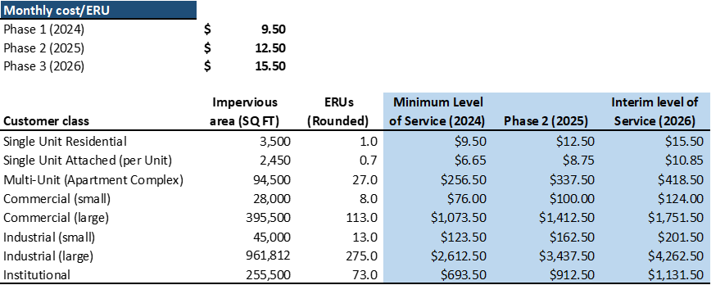
Example monthly stormwater rates

Slide 11
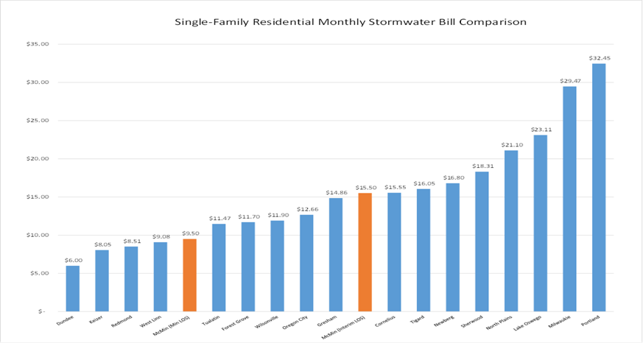
Updated single family stormwater rate survey

Slide 12

Policy issues previously reviewed by the committee:
FINANCIAL RECOMMENDATIONS

Slide 13
Revenue requirements:
The Committee recommends revenue requirements begin with the minimum level of service and transition to interim revenue requirements over a three-year (3) period.
Policy issues previously reviewed by the committee:

Slide 14
Risk management:
The Committee recommends expenses required to meet water quality regulatory requirements be fully funded to meet community values and avoid enforcement penalties and potential third-party litigation.
Policy issues previously reviewed by the committee:

Slide 15
Franchise fee deferral
The Committee recommends the franchise fee be deferred for a minimum of three years and then considered as a dedicated transfer to the Street Fund.
Policy issues previously reviewed by the committee:

Slide 16
Assistance to low-income households
  The Committee recommends the Stormwater Utility provide assistance to low-income households on a pro rata basis, similar to assistance provided by the Wastewater Fund.
Policy issues previously reviewed by the committee:

Slide 17

Policy issues previously reviewed by the committee:
RATE STRUCTURE

Slide 18
Single family residential rate
The Committee recommends single family residential properties be billed based on the median measured impervious area of 3,500 square feet (1 Equivalent Residential Unit, ERU)
Policy issues previously reviewed by the committee:

Slide 19
Multifamily/Commercial/Industrial/Institutional
    The Committee recommends billings for non-single family residential properties be based on measured impervious areas and expressed as ERUs.
Policy issues previously reviewed by the committee:

Slide 20
Billing for city and McMinnville Water and Light properties
The Committee recommends city and McMinnville Water and Light properties not be billed for stormwater services, similar to billing policies for water and wastewater services.
Policy issues previously reviewed by the committee:

Slide 21
Shift to tiered residential rate structure
  The Committee recommends a single rate be used for single family residential properties initially.
  Upon completion of the Stormwater Master Plan Update, the Committee strongly supports moving to a tiered rate structure for single family properties as a more equitable billing structure.
Policy issues previously reviewed by the committee:

Slide 22
Administrative appeal
The Committee recommends the implementing ordinance adopting the stormwater utility include a provision for administrative appeals to reconcile any errors or changes in measurement of impervious areas.
Policy issues previously reviewed by the committee:

Slide 23
Discounts/Credits
The Committee recommends a 35% discount be given to non-single-family dwellings that are fully self-contained, discharge to streams or rivers not maintained by the city and that are regulated by discharge permits from the State Department of Environmental Quality.
The Committee does not recommend discounts or credits for privately maintained stormwater systems be granted until further considered as part of the Stormwater Master Plan Update.
Policy issues previously reviewed by the committee:

Slide 24

Policy issues previously reviewed by the committee:
BILLING POLICIES

Slide 25
Coordination with
McMinnville Water and Light
The Committee recommends the city work with McMinnville Water and Light to incorporate stormwater utility billing in their monthly billing statements.
Policy issues previously reviewed by the committee:

Slide 26
Minimum impervious area for
non-residential billing
The Committee recommends a minimum billable impervious area of 500 square feet be used for billing non-single family residential properties.
Policy issues previously reviewed by the committee:

Slide 27
Rounding for non-residential customers
The Committee recommends billing for non-single family residential properties be rounded up to the nearest whole ERU.
Policy issues previously reviewed by the committee:

Slide 28
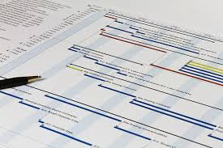
Policy issues previously reviewed by the committee:
NEXT STEPS

Slide 29
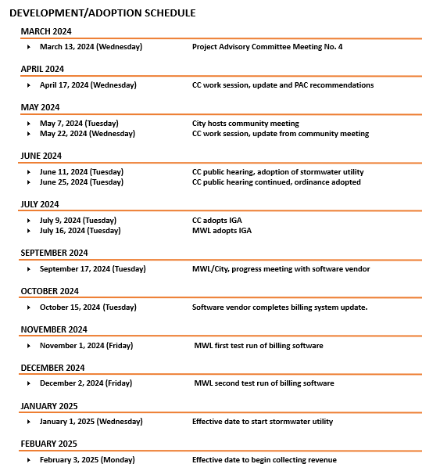
Next Steps:
Preliminary schedule

