Slide 1
Stormwater/Wastewater Project Advisory Committee
February 13, 2024

Slide 2
Agenda
Introductions Leland Koester 12:00 PM –12:05 PM
Overview/Agenda Chip Ullstad 12:05 PM – 12:10 PM
GIS Methodology/Update Chip Ullstad 12:10 PM – 12:20 PM
Updated Revenue Requirements James Lofton 12:20 PM - 12:30 PM
Rate Phasing/Comparison Deb Galardi 12:30 PM – 12:40 PM
Questions, December’s mtg. All 12:40 PM – 12:55 PM
Policy Questions Committee 12:55 PM – 2:55 PM
Schedule review/Next Steps Chip Ullstad 2:55 PM – 3:00 PM

Slide 3
Overview
WHERE WE’VE BEEN
Meeting No. 1, October 16, 2023
PAC role and timeline
Stormwater principles
Infrastructure challenges
Regulatory requirements
Current funding
Stormwater utility concepts
Meeting No. 2, December 5, 2023
GIS process and basis for ERU
Upcoming policy issues
Rate structure
Sample rates
WHERE WE’RE GOING
Meeting No. 3, February 13,2024
Policy/Recommendations
Meeting No. 4, March 13, 2024 (if needed)
Policy/Recommendations
City Council work session, April 17, 2024

Slide 4
GIS Update
Data Correction
Foundation of Stormwater Utility
Mean ERU impervious area
Preliminary estimate, 3,512 sf
Revised estimate, 3,499 sf
Consequence, no change as rounded to 3,500 sf
Total number of ERUs in service area
Mistakenly used UGB instead of City Limits
Preliminary estimate, 28,059 ERUs
Revised estimate, 24,240 ERUs
Consequence, higher rate/ERU ($12.50 to $14.50, +16%)

Slide 5
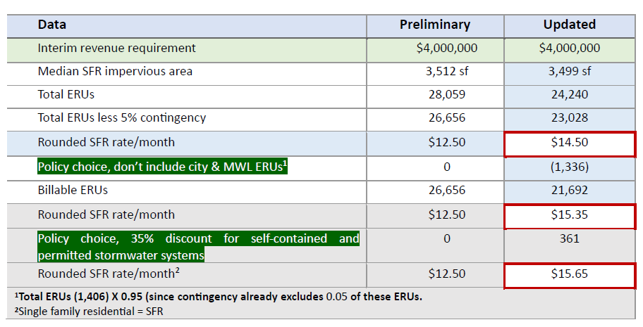
GIS Update

Slide 6
Optional revenue targets/level of service
Minimum level of service
Annual revenue = $2.4 M
High priority repairs only
Limited capital
No preventative maintenance program
Delayed franchise fee (?)
Interim level of service
Annual revenue = $4.0 M
Stormwater Master Plan Update
Begin high priority capital projects
Repayment of Wastewater Fund for Stormwater Utility Development
Full participation in administrative/transfer revenue
Fully funded level of Service
Revenue requirements = $ TBD
Completion of Stormwater Master Plan update
Development of financial plan
Development of user fees based on capital projects and timing

Slide 7
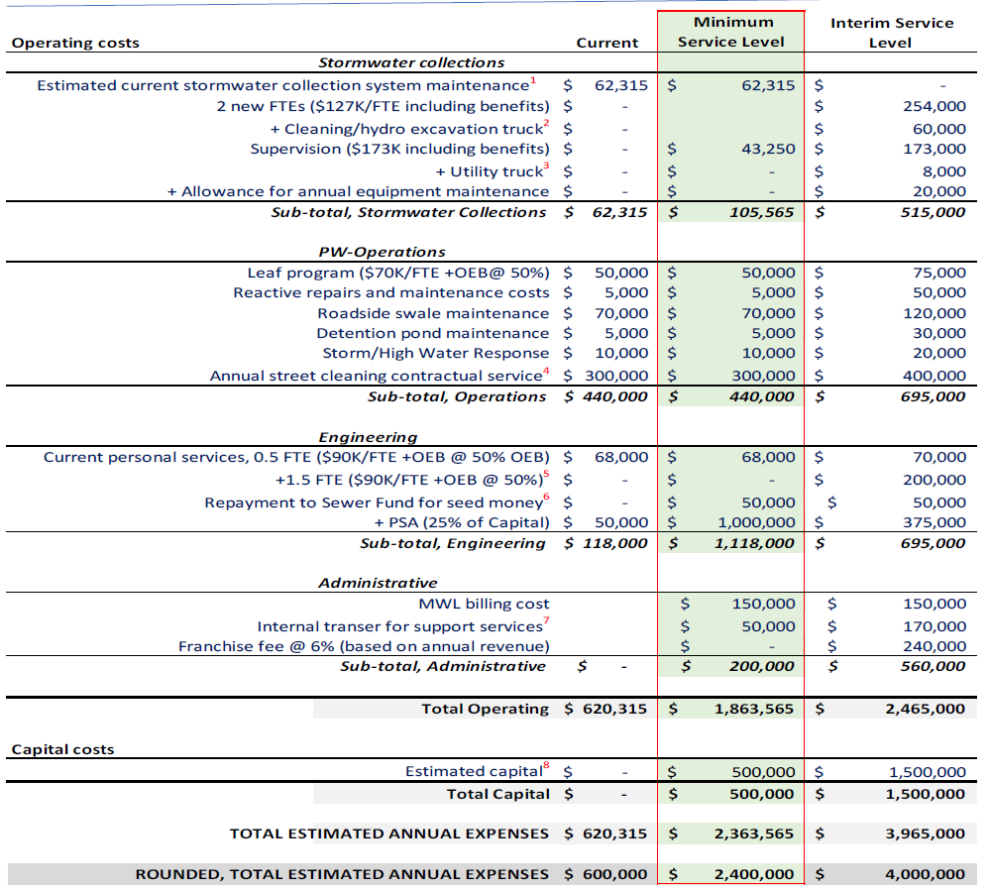
Optional revenue targets/level of service

Slide 8
Questions from December 5, 2023, Meeting
Equivalent Residential Unit (ERU) impervious area seems too large
GIS consultant and city GIS staff reviewed sample median residential impervious areas and confirmed that 3,500 sf is representative, with nominal difference (3,512 sf – 3,499 sf). Median ERU values were recalculated to reflect only parcels in city limits.

Slide 9
Questions from December 5, 2023, Meeting
How will the city manage the initial revenue shortfall?
The utility will be self-funded to the greatest extent practical. Expenses will be managed consistent with incoming revenue stream
During the transition Wastewater and Street Funds will continue to fill in the gap to meet essential needs.

Slide 10
Questions from December 5, 2023, Meeting
Prepare a listing of short-term capital projects (replacements/repairs)
High priority capital projects
Address 48” failing storm sewer/emergency sanitary sewer overflow adjacent to the existng wetlands north of Joe Dancer Park
Address aging and undercapacity storm system elements tributary to and downstream of 13th and Galloway causing localized flooding and on-going emergency response
Replacement of failed storm sewers in downtown along 3rd Street
High priority system repairs
Replace a section of failed storm drain between NW 11th and Elm. Broken joints and substantial root intrusion compromise the storm drain’s capacity and has resulted in localized flooding.
Replace 60’ of storm drain tributary to the north branch of Cozine Creek. Heavy root intrusion and offset joints compromise the storm drain’s capacity.
Replace catch basin at NE 14th and McDonald. Broken joints have caused a sink hole.
Replace catch basin at NE 14th and Johnson. Broken joints have caused a sink hole.
Replace/repair catch basin at NW 12th and Irvine. Defects and failure of the catch basin walls has caused a sink hole.

Slide 11
Questions from December 5, 2023, Meeting
How will the city bill parcels that don’t have water, wastewater, or power accounts?
Staff and MWL have started working together to incorporate the stormwater utility bills with current billings for water, sanitary sewer, and power services.
We anticipate there are relatively few propeties unserved by other utilities. These propeties will be billed as “stormwater only” accounts.

Slide 12
Questions from December 5, 2023, Meeting
What is the city’s liability if stormwater services aren’t funded to meet regulatory mandates?
The city has a duty to comply with environmental mandates. Enforcement includes progressive civil fines up to a maximum of $25,000/day/violation if the city fails to meaningfully engage in management of our stormwater network.

Slide 13
Questions from December 5, 2023, Meeting
Can billing include land use, i.e., bill commercial differently?
Using a combination of land use and impervious area is uncommon, complex, but doable. Stormwater Utility is new, and we don’t have data needed to pursue this combined billing structure.

Slide 14
Questions from December 5, 2023, Meeting
How much money from wastewater and street funds is used for the stormwater system currently?

Slide 15
Policy Question
Should the city charge a stormwater utility fee for city owned and McMinnville Water and Light parcels?
Pros: Including city and MWL properties will result in lower rates for all customer classes.
Cons: Excluding city owned parcels results in a higher rate for all customer classes, approximately $0.85/ERU/month ($14.50 to $15.35). This change would be revenue neutral.
Departure from the city’s current approach of not billing these properties for water and sewer services. Wastewater, Street, Airport and General Funds would pay a stormwater fee, resulting in increased user fees or reduced budgets for their targeted services.
Proposal: Staff propose not charging city owned and MWL properties for stormwater service. Charging city and MWL parcels a stormwater fee would provide nominal benefit in terms of equity and result in increased administrative costs for billing..

Slide 16
Policy Question
How will the city account for self-contained and permitted, non-single family stormwater systems that drain to waterways not maintained by the city?
Pros: Providing a discount for properties that discharge to a permitted stormwater system provides a lower rate for reduced benefit.
Cons: Providing a 35% discount on the estimated qualifying ERUs results in the preliminary rate increasing from $15.35 ERU/month $15.65/ERU/month.
Proposal: Staff propose properties with fully self-contained, separately permitted stormwater systems be discounted up to a 35% of the user fee.

Slide 17
Policy Question
Should billing be phased in?
Pros: Phasing in rates will allow customers, especially large non-residential customers, an opportunity to budget for a new utility bill over the phase in period.
Cons: Phasing the stormwater utility fee will extend transition to an interim level of service. This will require continued reliance on Wastewater, Street and General funds until the phase in period is completed.
Proposal: Staff does not have a proposal for phasing in stormwater utility rates.

Slide 18
Policy Question

Slide 19
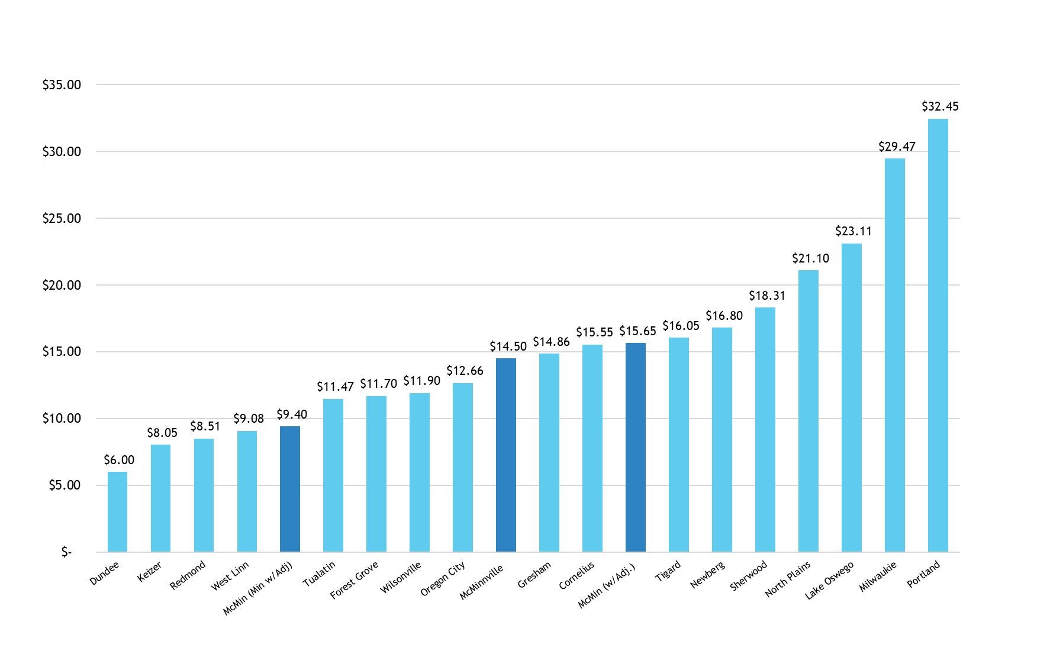
Policy Question

Slide 20
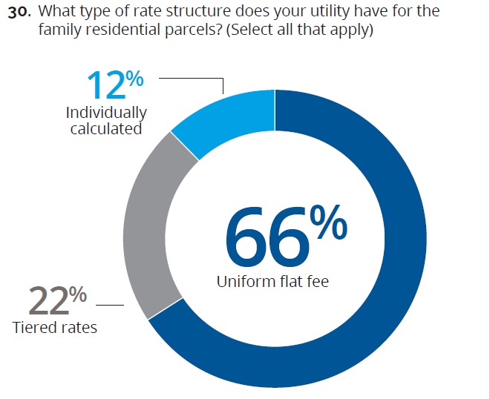
Policy Question
Should residential rates be tiered?
Pros: Enhanced equity for single unit residential customers.
Cons: Added costs and complexity in rate structure and administrative processes. Additional time to gather data and implement.
Proposal: Uniform fee in the short-term; consider tiered structure as a longer-term recommendation.
Dedicated funding source for stormwater needed for upcoming fiscal year.
Structure will add costs to developed; delayed implementation will cost program in lost revenue.
Uniform structure consistent with majority of utilities.
Source: 2021 Stormwater Utility Survey Report (Black & Veatch)

Slide 21
Policy Question
Should the stormwater utility have an administrative appeal provision?
Pros: Establishes an administrative appeal process for stormwater user fees based on new or corrected information.
Cons: Staff doesn’t anticipate a downside to an administrative appeal process.
Staff proposal: An appeal process be included in the implementing ordinance forming the stormwater utility.

Slide 22
Policy Question
Should the stormwater provide assistance to low-income households?
Pros: The city participates in a program to assist low-income households offset sewer user fees. MWL also participates in this program.
Cons: Staff doesn’t anticipate revenue constraints if the Stormwater Fund participates on a pro-rata basis to the Wastewater Fund.
Proposal: Staff propose the Stormwater Utility provide low-income household assistance on a pro-rata basis, similar to the Wastewater Fund.

Slide 23
Policy Question
Should billing for mobile homes be less than SFR rate?
Pros: The proposed billing approach is consistent with billing single family dwellings, 1 ERU and billing multifamily units on a single parcel based on measured impervious area.
Cons: If mobile or manufactured homes are not served by individual water meters (e.g. master metered for the parcel), the property owner will need to allocate stormwater billings.
Staff proposal: Mobile and manufactured homes on a single parcel billed as 1 ERU, multiple mobile and manufactured homes be billed on measured impervious area, similar to multifamily properties.

Slide 24
Policy Question
What should the minimum billable impervious area be and how should ERUs be rounded?
Pros: A minimum billing impervious area of 350 sf is consistent with our consultant’s recommendation and should avoid billing parcels with sliver overlaps on tax lots.
Rounding up to the nearest whole ERUs for non-single-family properties is less complex to administer and more straight forward for billing purposes.
Cons: Rounding to the nearest ERU is less equitable for parcels with nominal differences in impervious areas.
Proposal: Staff propose rounding non-single family residential properties to the nearest whole ERU. Single family attached properties would be charged based on the average ERU value of 0.7.

Slide 25
Policy Question
Can the city defer collection of franchise fees for three years to allow the stormwater utility to build reserves?
Pros: Delaying franchise fees for a three-year period will coincide with completion of rate phasing (if adopted) and allow the utility to build a modest reserve.
Cons: Franchise fees are unrestricted General Fund revenue. By deferring collection of franchise fees for the stormwater utility, the General Fund will forego $570,000 to $720,000 depending on the Committee’s phasing recommendation.
Proposal: Staff does not have a proposal for delaying franchise fees.

Slide 26
Policy Question
Will customers be eligible for a stormwater rate reduction discount for onsite detention?
Pros: Providing discounts may encourage more robust maintenance and care of the basins post development.
Cons: Providing a discount for routine maintenance of these private facilities will shift overall costs or rates to other customer classes.
Proposal: Staff propose a stormwater discount program be developed after the initial billing system is in place, the stormwater master plan update is underway and system design standards have been updated.

Slide 27
Policy Question
Should stormwater bills be discounted for privately constructed and maintained stormwater systems?
Pros: Property owners with private stormwater systems have maintenance and repair responsibilities that are typically funded by a homeowner's association. A discount will provide reduced utility fees to these customers in recognition of these added costs.
Cons: Providing a discount to properties served by these systems shifts costs from developers to other customers through higher rates.
Proposal: Staff propose the city not discount user fees for customers served by private stormwater systems.

Slide 28
Policy Question
Should the city continue to use street fund revenues to pay for stormwater services in the public right-of-way.
Base assumption: Curbs, gutters and catch basins are integral to the stormwater system. Street sweeping is a stormwater related service.
Pros: Reduces revenue requirements and stormwater rates.
Cons: Continues to divert limited revenue needed for street preservation purposes.
Proposal: Consistent with industry practices, include street sweeping and emergency response to localized flooding in stormwater revenue requirements.
Allocation of all stormwater costs based on impervious area is accepted practice.

Slide 29
Next Steps
February 13, 2024: Utility Policy Recommendations
March 13, 2024: If needed (Committee’s direction) for additional policy discussion/recommendations
April 17, 2024: Present recommendations to City Council at a work session
May 2024: City Council considers adoption of a Stormwater Utility Committee begins discussion of sewer utility rates and SDCs
August 2024: If adopted by City Council, begin billing for Stormwater Utility
Q
29

Slide 31
BACKGROUND SLDES IF NEEDED

Slide 32
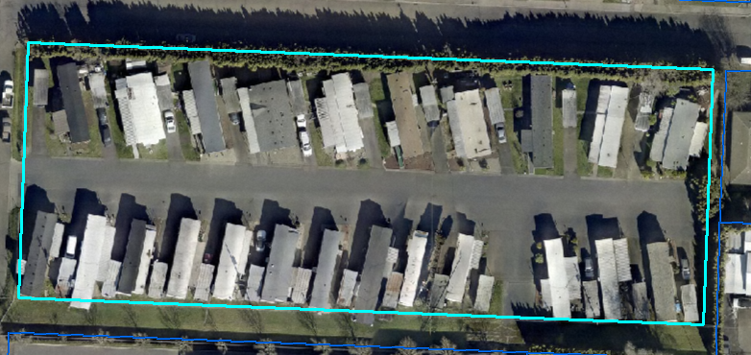
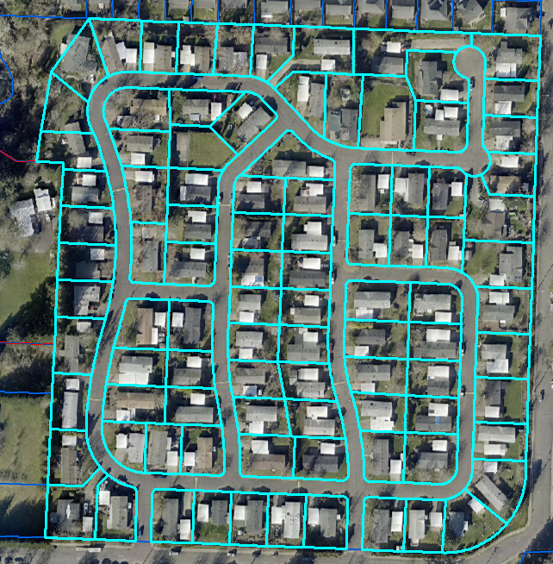
Mobile Home/Manufactured Home Properties
One home per parcel – SFR
More than one home per parcel – Non-single-family residential (NSFR)

Slide 33
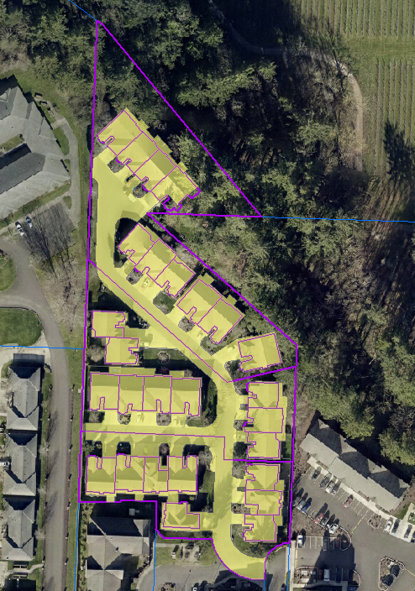
Single-Family Attached (SFA) Properties
Attached units located on individual parcels – often smaller than SFR parcels
Share common area IA
Impervious area for SFA properties and common areas was measured
Notes:
This example community has 30 parcels total with 3 common area parcels and a total IA of almost 92k square feet.

Slide 34
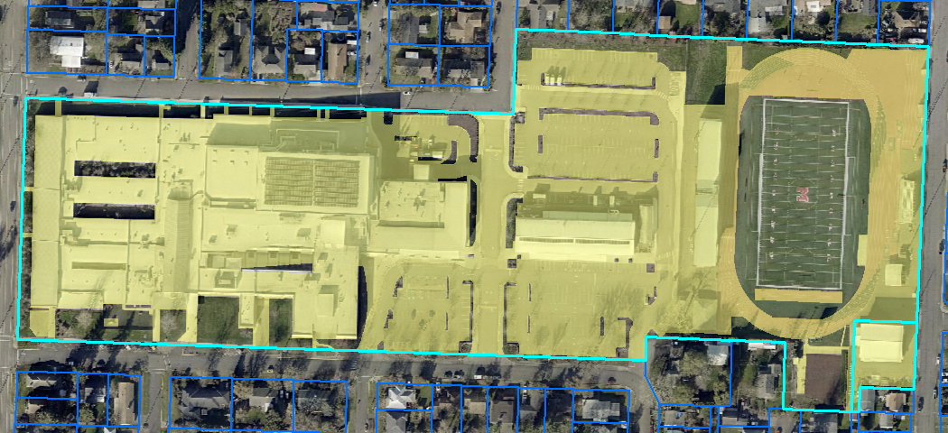
Non-Single Family Residential (NSFR) Properties
1,613 NSFR Parcels in McMinnville – 1,469 developed with IA
Total IA divided by ERU value to calculate billable ERUs

